Slide 1
FOR LEASE: 2,100 sf – 24,844 SF
Heritage Town Center
873 Denison Avenue SW, Birmingham, AL 35211
Bill Clements, CCIM Brooks Corr, CCIM
205.823.3070 205.823.3080
Bill@TheRetailCompanies.com Brooks@TheRetailCompanies.com
1841 Montclaire Lane, Suite 102
Birmingham, AL 35216
TheRetailCompanies.com
205.823.3030

Slide 2
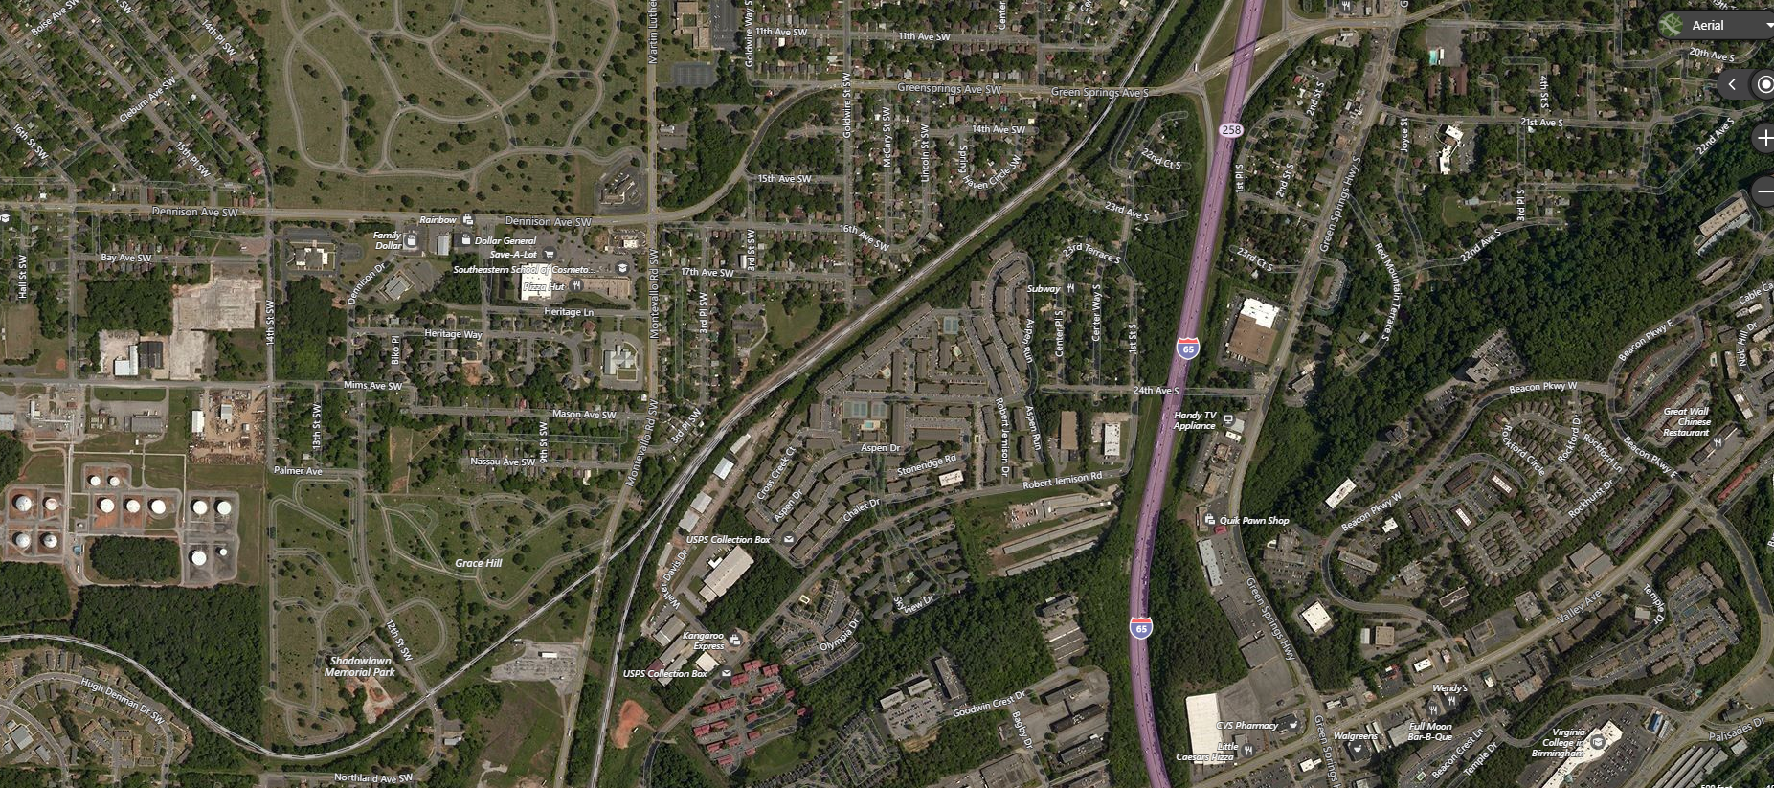
FOR LEASE: 2,100 sf – 24,844 SF
Heritage Town Center
873 Denison Avenue SW, Birmingham, AL 35211
85,289 sf Grocery-anchored center with a mix of national tenants including Save-A-Lot, Rainbow, Subway, and H&R Block
24,844 sf Endcap Junior Box Available
9,450 & 2,100 sf also Available
Excellent visibility with ample well lit, drive-up parking and pylon signage.
DISTANCE | POPULATION | MEDIAN INCOME
1 MILE | 9,695 | $42,647
3 MILES | 85,975 | $47,967
5 MILES | 184.798 | $62,551
TRAFFIC COUNTS: _____ VPD
NO WARRANTY EXPRESSED OR IMPLIED HAS BEEN MADE AS TO THE ACCURACY OF THE INFORMATION PROVIDED HEREIN, NO LIABILITY FOR ERROR OR OMISSIONS.

Slide 3
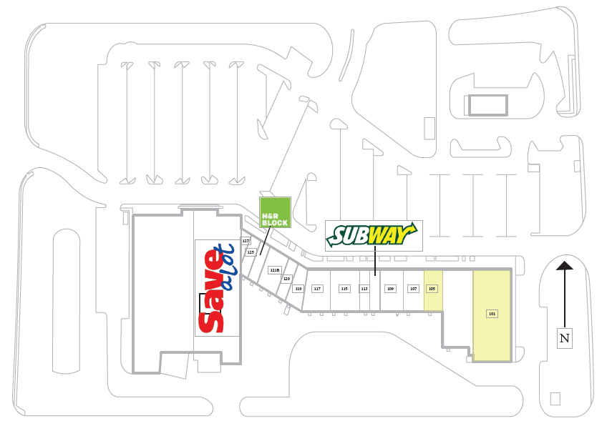


FOR LEASE: 2,100 sf – 24,844 SF
Heritage Town Center
873 Denison Avenue SW, Birmingham, AL 35211
24,844 sf
2,100 sf
9,450 sf
NO WARRANTY EXPRESSED OR IMPLIED HAS BEEN MADE AS TO THE ACCURACY OF THE INFORMATION PROVIDED HEREIN, NO LIABILITY FOR ERROR OR OMISSIONS.

